Slide 1
R1 Project Demo
Neighborhood Tool Sharing
Group 3 | ICS 613
Summer 2026
Team Members
Rion Sawabe Ivan Wu Yafei Wang Nick Fairhart Loreto Coloma
Notes:
PM

Slide 2
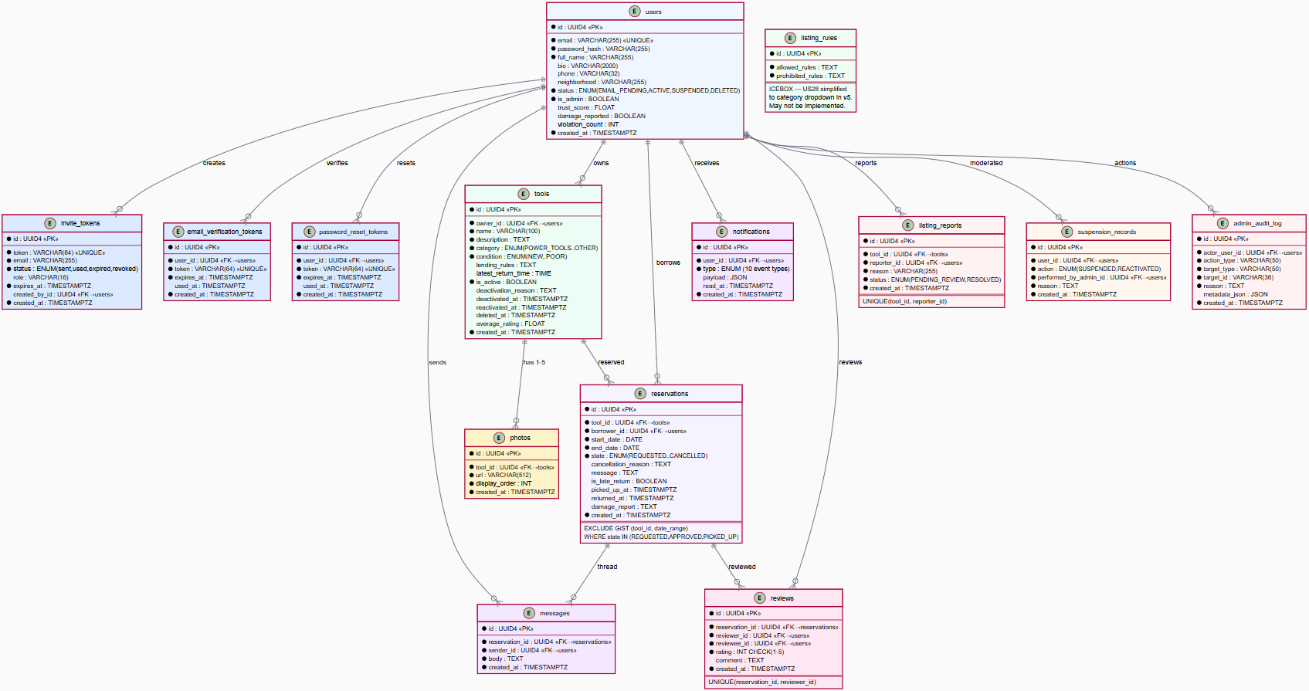
Overview of the Domain Model and ER diagram
8 Entities, 5 Core Relationships
User, Tool, Reservation, Review, Invite, Photo, Notification, AdminAuditLog
User owns Tools • User borrows via Reservations
Reservation → Review (one per party)
Tool → Photos (1–5 scale limit)
Key DB Constraints
GiST EXCLUDE on (tool_id, daterange) — strictly prevents any double-booking
UNIQUE (reservation_id, reviewer_id) — limits to one review per party
Soft-delete with PII anonymization & active-reservation guard
Enums: 5 ToolCategory · 5 ToolCondition · 6 ReservationState · 14 NotificationType
Notes:
Backend Lead

Slide 3
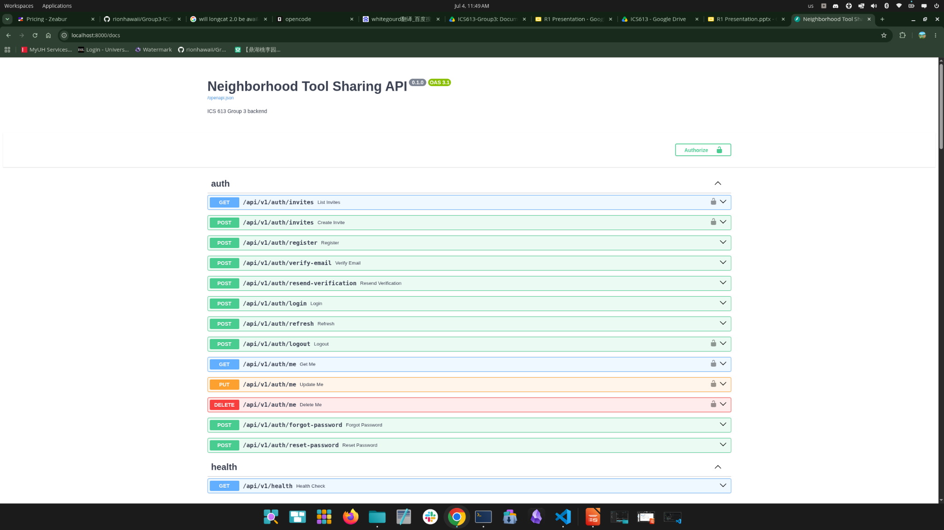
Major Accomplishments — Backend
Backend
46 Endpoints / 7 Routers Fully Implemented & Tested
Comprehensive coverage of core services ensuring robust data layers and business logic.
Endpoint Breakdown:
• Auth: 13 endpoints
• Tools: 11 endpoints
• Reservations: 10 endpoints
• Reviews: 5 endpoints
• Admin: 4 endpoints
• Notifications & Health: 3 endpoints
Infrastructure Highlights
JWT Security: Access & refresh tokens with automatic rotation.
Rate Limiting: Configurable active protection on all auth endpoints.
Double-booking guard: GiST EXCLUDE at DB level and app-level overlap check.
APScheduler: Automated stale cancels, escalations, and cleanups.
Photo Uploads: Magic-byte validated with a 5 MB disk limit.
Notes:
Frontend, Backend, DevOps

Slide 4
Major Accomplishments — Frontend
Core Member Workflow
Reservation + Review Workflow
Built R1 member-facing pages for login, registration with invite token, email verification, forgot/reset password, profile setup, and edit profile.
Added mock authentication behavior using frontend state/localStorage so the R1 demo can show login/logout and protected member navigation.
Built reservation workflow UI for requesting a tool, owner approve/deny/cancel actions, borrower cancel, confirm pickup, and confirm return.
Added returned-reservation review support, including Leave Review flow and Review History page.
Added frontend reservation conflict messages and future backend-ready conflict wording for overlapping reservation dates.
Tool Listing Workflow
Notifications + Admin Support
Implemented major tool-sharing pages: Browse Tools, Tool Detail, Create Tool Listing, and Edit Tool Listing.
Added frontend validation for required fields, photo upload limits, duplicate tool names, latest return time format, and HST date/time labels.
Added owner-side delete/deactivate listing UI, including active-reservation blocking and confirmation behavior.
Improved the Notification Center with unread/read filters, notification badges, Mark as Read, Mark All as Read, and Dashboard notification sync.
Added basic admin/demo pages, including Admin Invite Management and Admin Listing Controls.
Added R1 support for overdue pickup / auto-cancel notice UI to show how stale approved reservations will be handled.
Build / Testing Status
■
Tested locally with npm run build.
■
Changes were committed and pushed to feat/yafei-frontend.
■
Frontend is structured for later backend API integration and is fully demo-ready using mock data.

Slide 5
Major Changes to requirements
Some User Stories have changes
New User Story: Admin Invites a New Member
Priority is high. Included in R1 milestone.
Iceboxed User Stories: User Story 28 (Tool Categories) & User Story 33 (Admin Reports Export)
Priority is low.
Notes:
PM

Slide 6
Project Management Approach
Not changed but proposed plan: Transferring our repository to the GitHub organization
We now use the PM’s personal repository
Members’ user privileges are limited
We plan to discuss at the next meeting
Notes:
PM

Slide 7
Key Risks & Mitigation Strategies Update
No additional risks identified
Discord is strongly leveraged for consistent and timely communication during development
Members continue to offer support and ideas proactively
Use of GitHub organization to provide broader team access to repository settings
Notes:
Document Lead
Were there any risks identified in Project Initiation that materialized?
How were they addressed?

Slide 8
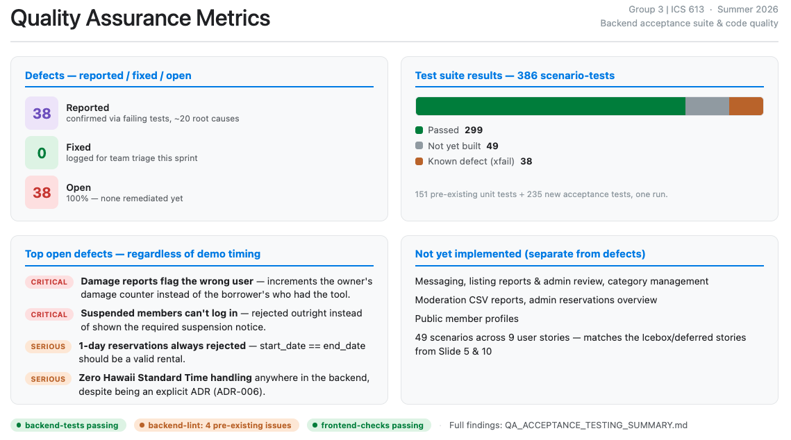
Quality Assurance Metrics
Defects reported, fixed, open, etc.
Code quality metrics, unit test coverage
Notes:
QA Lead

Slide 9
Milestones
Missed/Postponed
Upcoming
10 deferred User Stories (of the 35 created)
Testing and
Version 2 Release
Documentation Compilation
Showcase
Deferred user stories covered additional functionality for users and mostly admin tools
July 14: Manual test cases created in addition to CI/CD workflow
Aug 6: Deployment Guide; updated GitHub
Narrowed scope for initial launch and R1 demo
July 27: All deferred user stories included in updated release. Potential bug fixes after additional testing.
Aug 13: Final presentation and demo

Slide 10
Next Steps
1
Deferred User Stories
2
Improvements
3
TBD/Icebox
Functionality
Usability
Additional Admin Tools
Admin Tools
R1 Retrospective
Timezone normalization
Reservation messaging
Notification center UI
Member: Reporting a listing
Pagination on all list endpoints
Advanced search filters
Managing tool categories (CRUD API)
Generate community moderation reports
Review reports
Track violations
Suspend/reactivate a member
Moderation history
Bug fixes for potential issues identified after R1

Slide 11
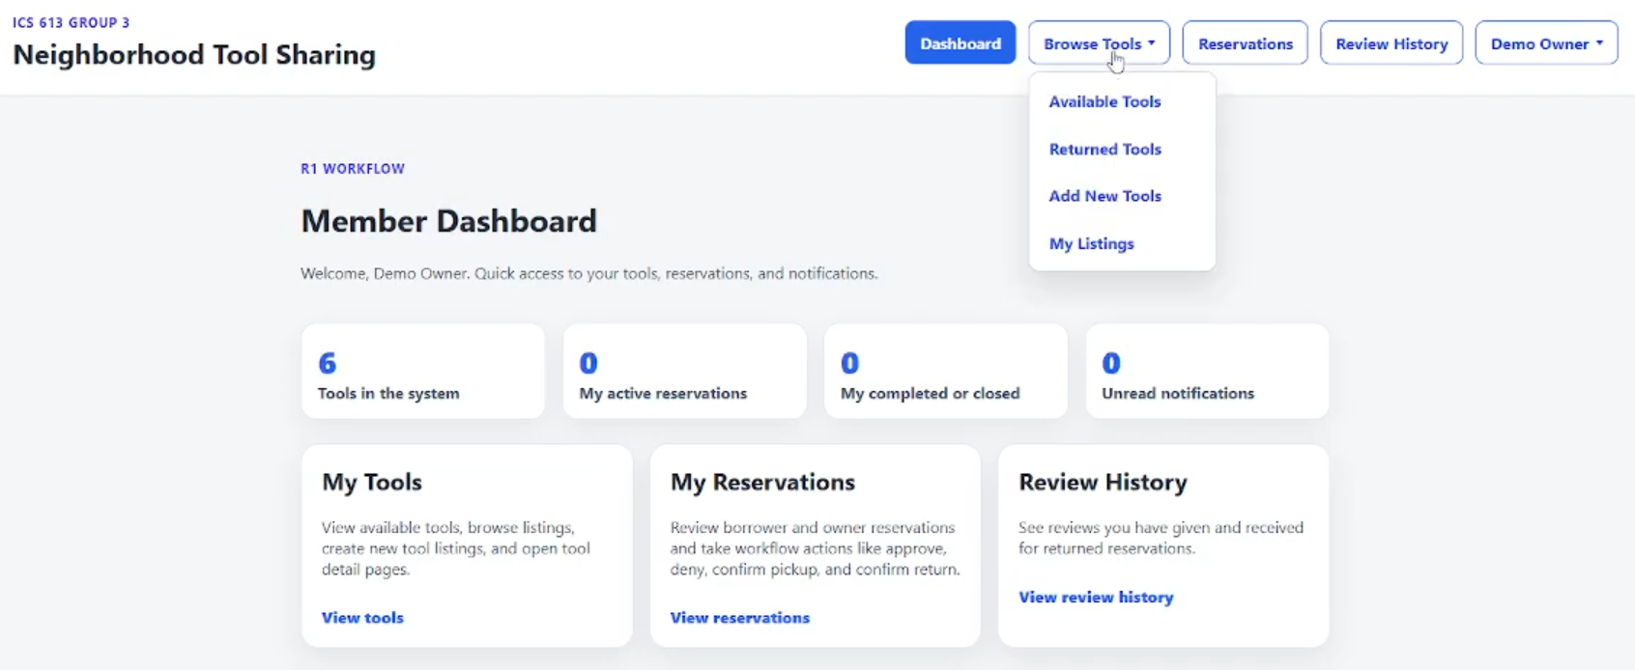
Neighborhood Tool Sharing Demo
Admin Invitation of New User, Tool Deactivation/Reactivation, Member Sign-up
Notes:
In addition to demonstrating key functionality in the live demo, teams should be prepared to conduct a code walkthrough and explain key components of the codebase.

Slide 12
Thank you!
Questions?

